Slide 1
VIRTUAL MOUSE
DEEPIKA P [211418104046]
JANANI N [211418104094]
JANET JESSICA R [211418104095]
Guide Name
Dr. L. JABASHEELA,M.E.,Ph.D.,

Slide 2
INTRODUCTION
It is believed that gestures are the easiest way of interaction with anyone. So then why not apply it to the machines that we are using. In our work Virtual Mouse aims to eliminate the needs of having a physical mouse while able to interact with the computer system through webcam by using various image processing techniques. It promotes an approach for the Human Computer Interaction (HCI) where it utilizes a camera and computer vision technology to control various mouse events and is capable of performing every task that the physical computer mouse can and it mainly focuses on extracting the features over the human hands and then matching their features to recognize the movement of the hand.

Slide 3
LITERATURE SURVEY
SOURCE | TITLE | METHODOLOGY | FINDINGS
Banda Aneela , Narlanka Vasuki, Rebelli Sai Sahana, Charupalli Sunil Kumar(IEEE) 2021 | Implementing a Real Time Virtual Mouse System and Fingertip Detection based on Artificial Intelligence | Detecting hand landmarks | More accuracy
Sherin Mohammed Sali Shaiideen: VH Preetha (IEEE) 2019 Vantukala VishnuTeja Reddy1, Thumma Dhyanchand2, Galla Vamsi Krishna3, Satish Maheshwaram(IEEE) 2019 | Hand Gestures - Virtual Mouse for Human Computer Interaction Virtual Mouse Control Using hand gloves | Accurate values in finger pointing with 3-D space Robotic arm | Started detecting complete hand with palms and fingers All gesture were identified

Slide 4
Tiwari, Siddhi Parkar, Shruti Gharat, Kinjal Patel, Prof. Khalil Pinjari (IEEE)2019 | Design and Development of Hand Gesture Based Virtual Mouse | Histogram analysis of skin pixels | Started to identify digits in fingers
Kollipara Sai Varun, I. Puneeth, Dr. T. Prem Jacob (IEEE)2019 | Virtual Mouse Implementation using Open CV | Real-time computer vision, Deep Learning | Able to identify fingers more accurate
Swati Tiwari, Siddhi Parkar, Shruti Gharat, Kinjal Patel, Prof. Khalil Pinjari(IEEE)2018 | Virtual mouse using sixth sense technology | Frame extraction | Increased clarity
Sherin Mohammed Sali Shajideen Preetha V H(IEEE)2018 | Virtual Mouse for Human Computer Interaction | Tracking 3D models using dual cameras | Identifies 3D gestures in hand

Slide 5
Changhyun jeon, oh-jin kwon, dongil shin, and dongkyoo shin(IEEE)2018 | Hand-Mouse Interface Using Virtual Monitor Concept for Natural Interaction | Whole skeleton | Removing physical mouse
Itsuo Kumazawa, Toshihiro Kai, Yoshikazu Onuki, and Shunsuke Ono (IEEE)2017 | Measurement of 3D-Velocity by High-Frame-Rate Optical Mouse Sensors to Extrapolate 3D Position Captured | External mouse sensors | Increased speed, high accuracy
Upasana, V Monisha Joseph, Kanchana V.p(IEEE)2017 | Virtual Mouse with RGB Colored Tapes | Coded tapes | Identification was accurate

Slide 6
PROBLEM STATEMENT
The physical mouse that we use in our daily lives will ultimately wear down due to the movement of the mechanical components because it is constructed of moving parts. It’s no surprised that every technological devices have its own limitations, especially when it comes to computer devices. In addition to a flat working surface, using a physical mouse requires the installation of specialized gear. All these are required to operate the mouse. The duration a mouse lasts for you may be impacted by whether it is wired or wireless. The degree to which the performance of a physical mouse is dependent on the environment in which it is used makes it difficult to adapt to new configurations. As a result of this dependence, it can be challenging to adapt to new configurations.

Slide 7
DEVELOPMENT ENVIRONMENT
HARDWARE REQUIREMENTS
Processor -i3
RAM- 4 GB
Hard-disk- 500 MB
Webcam
Speakers
Microphone 3.5
SOFTWARE REQUIREMENTS
OS- Windows
Server- PyCharm
Scripting Language- Python

Slide 8
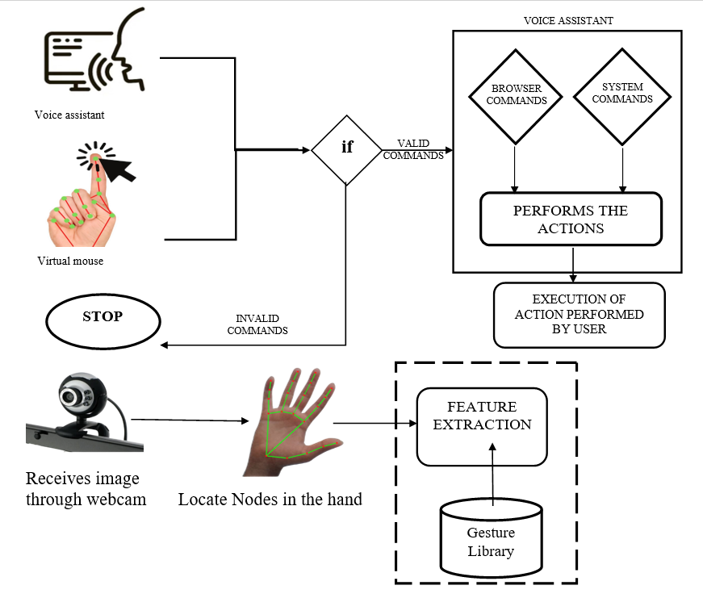
SYSTEM ARCHITECTURE

Slide 9
SYSTEM DESIGN
FLOW CHART
Hand image
C
Hand Detection
Pre processing
Feature Extraction
Gesture Dictionary
Recognition
Command
Execution

Slide 10
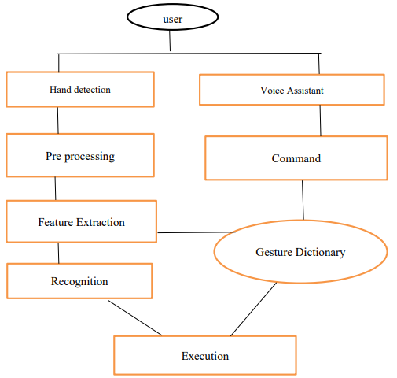
SYSTEM FLOW DIAGRAM

Slide 11
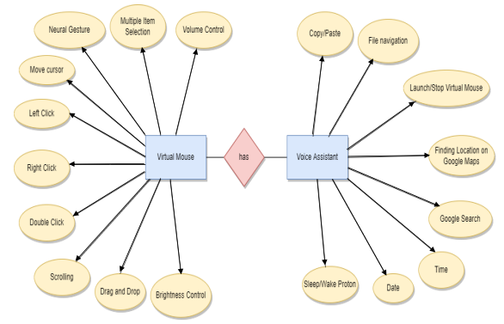
ER DIAGRAM

Slide 12
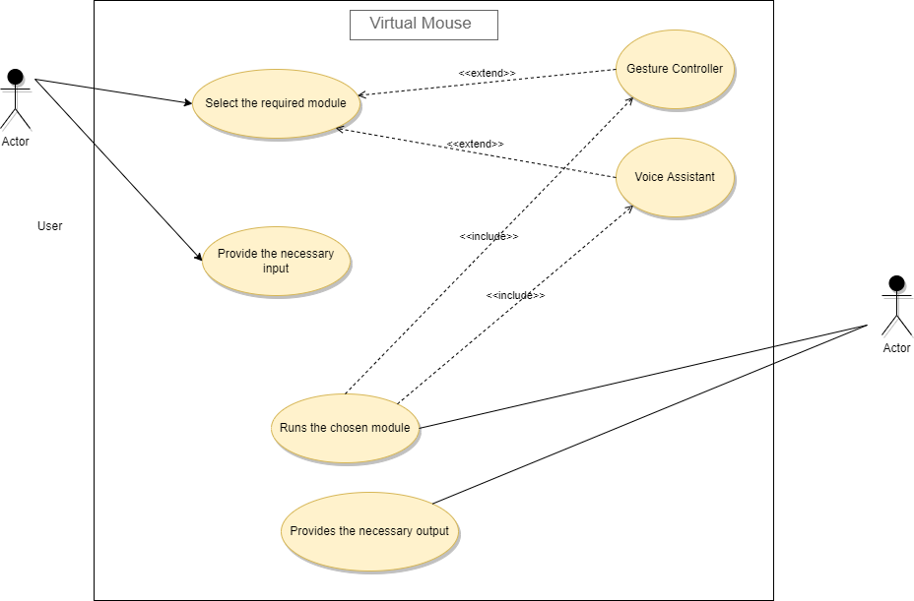
USECASE DIAGRAM

Slide 13
MODULES
Proton Activation Module – The voice assistant Proton can be activated by the command python proton.py.
Speech Recognition- This module is used for the conversion of text to speech in a program.
Launching gesture recognition – The user can also launch the gesture recognition system by proton.
Hand Detection Module – The nodes are detected.
Image Pre processing Module – The detected node image will be processed
Feature Extraction Module – The features are extracted from the gesture dictionary.
Execution Module– By recognizing those features, the virtual mouse will perform.

Slide 14
PERFORMANCE ANALYSIS
This data was recorded and was used for the analysis so that we could demonstrate that our model is more compatible with actual applications and more user friendly.
Gesture | Node detection | Success | Failure | Accuracy(%)
Mouse movement | 1 | 100 | 0 | 100
Left Click | 2 | 97 | 3 | 97
Right Click | 3 | 90 | 10 | 89
Click and Drag | 4 | 88 | 12 | 85
Double Click | 5 | 99 | 1 | 98.5
Neutral Gesture | 0 | 100 | 0 | 100
 |  | 574 | 26 | 95

Slide 15
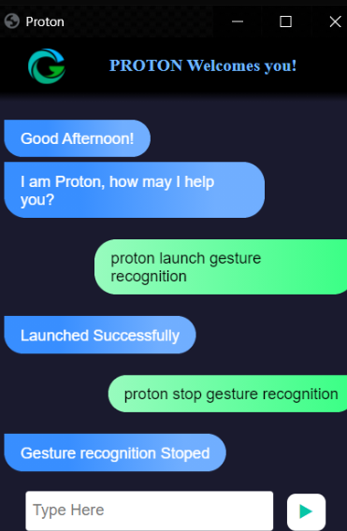
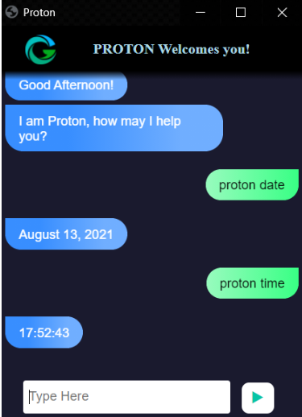
SAMPLE SCREENS

Slide 16
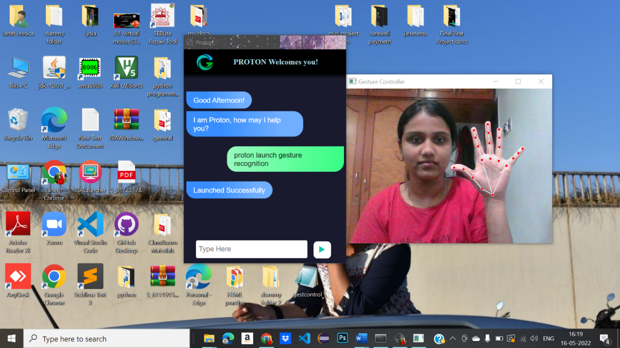
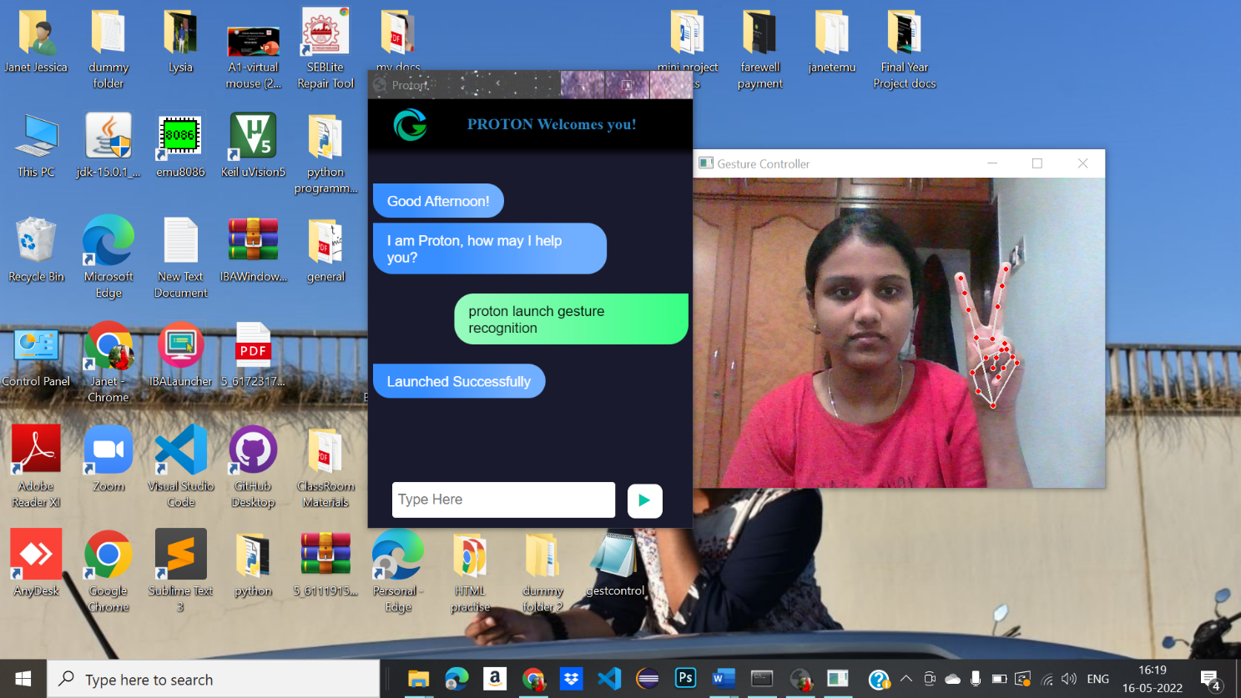

Slide 17
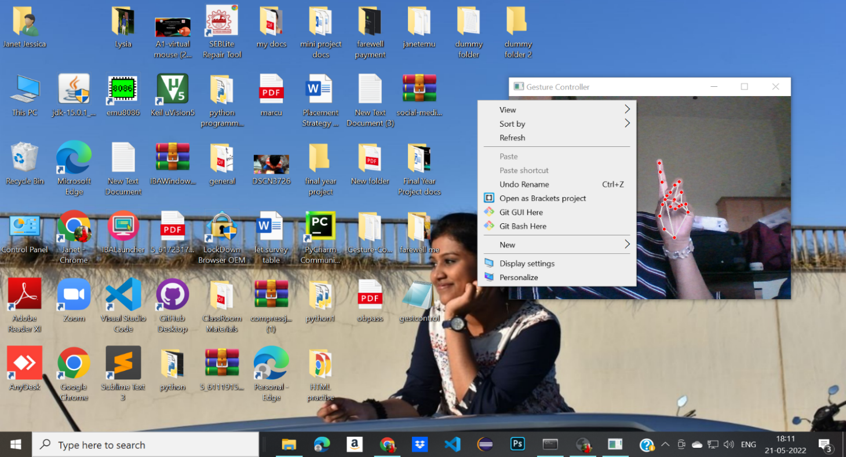
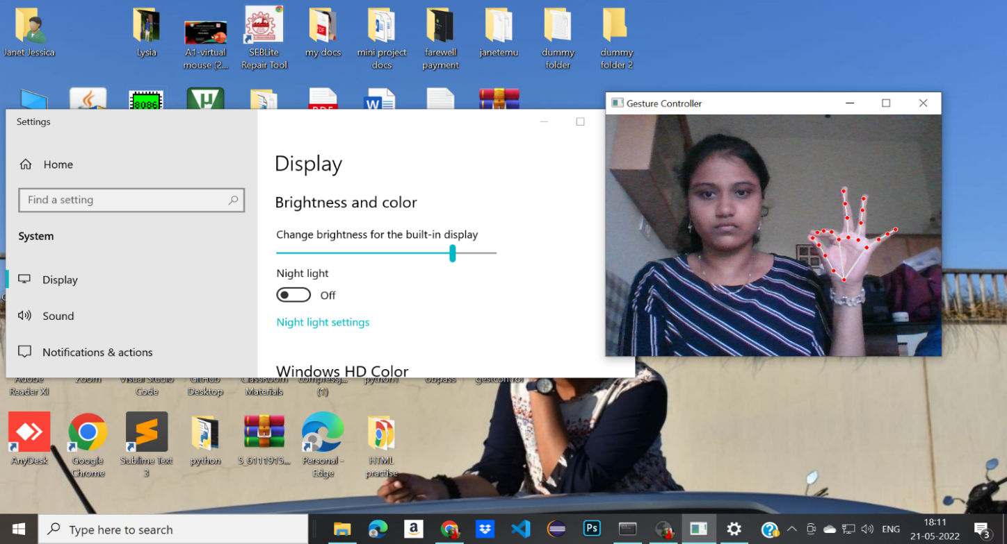

Slide 18
CONCLUSION
We have designed a system that will enable the physical mouse to be replaced with our own virtual mouse in the near future. The best way for a human to interact with a computer is through the use of a virtual mouse. The recognition of gestures is essential for the development of alternative modalities of interaction between humans and computers. We think that our virtual mouse is the best place to begin the process of bringing artificial intelligence-based modernization to the whole world.

Slide 19
REFERENCES
[1] Banda Aneela , Narlanka Vasuki, Rebelli Sai Sahana, Charupalli Sunil Kumar, (2021), ”Implementing a Real Time Virtual Mouse System and Fingertip Detection based on Artificial Intelligence”. Institute of Electrical and Electronics Engineering (IEEE), pp. 6299–6308.
[2] Sherin Mohammed Sali Shajideen; VH Preetha(2019) “Hand Gestures - Virtual Mouse for Human Computer Interaction” Institute of Electrical and Electronics Engineering(IEEE), pp. 5239–2301.
[3] Vantukala Vishnu Teja Reddy, Thumma Dhyanchand , Galla Vamsi Krishna , Satish Maheshwaram (2019), “Virtual Mouse Control Using hand gloves ” Institute of Electrical and Electronics Engineering(IEEE), pp. 1239–5239.
[4] Tiwari, Siddhi Parkar, Shruti Gharat, Kinjal Patel, Prof. Khalil Pinjari, (2019) “Design and Development of Hand Gesture Based Virtual Mouse”, Institute of Electrical and Electroncis Engineering(IEEE) , pp. 8745–3219.

Slide 20
[5] Y. Zhu, Z. Lan, S. Newsam, A. Hauptmann, “Hidden two-stream convolutional networks for action recognition,” Asian Conference on Computer Vision., pp. 363–378, 2018.
[6] B. Fang, F. Sun, H. Liu, C. Liu, “3D human gesture capturing and recognition by the IMMU-based data glove” Neurocomputing., vol. 277, pp. 198–207, 2018.
[7] O. Kopuklu, N. Kose, G. Rigoll, “Motion fused frames: Data level fusion strategy for hand gesture recognition,” Proceedings of the IEEE Conference on Computer Vision and Pattern Recognition Workshops (CVPR)., pp. 2103–211, 2018.
[8] J. Hou, G. Wang, X. Chen, J. H. Xue, “Spatial-temporal attention resTCN for skeleton-based dynamic hand gesture recognition,” Proceedings of the European Conference on Computer Vision (ECCV)., pp. 1– 9, 2018.
[9] J. C. Nunez, R. Cabido, J. J. Pantrigo, A. S. Montemayor, “Convolutional neural networks and long short-term memory for skeleton-based human activity and hand gesture recognition,” Pattern Recognition., vol. 76, pp. 80–94, 2018.
[10] A. Mhetar, B. K. Sriroop, A. G. S. Kavya, R. Nayak, R. Javali and K. V. Suma, "Virtual mouse," International Conference on Circuits, Communication, Control and Computing, Bangalore, pp. 69-72, 2018.

Slide 21
[11] Q. Gao, J. Liu, Z. Ju, “Robust real-time hand detection and localization for space human C robot interaction based on deep learning” Neurocomputing., 2019.
[12] Z. Cao, T. Simon, S. E. Wei, “Spatial-temporal attention res-TCN for skeleton-based dynamic hand gesture recognition,” Proceedings of the IEEE Conference on Computer Vision and Pattern Recognition (CVPR)., pp. 7291–7299, 2019.
[13] S. Woo, J. Park, J. Y. Lee, et al, “Cbam: Convolutional block attention module,” Proceedings of the European conference on computer vision (ECCV)., pp. 3–19, 2019.
[14] J. Carreira, A. Zisserman, “Quo vadis, action recognition? a new model and the kinetics dataset,” proceedings of the IEEE Conference on Computer Vision and Pattern Recognition., 2019, pp. 6299–6308.
[15] M. Abavisani, H. R. V. Joze, V. M.Patel, “Improving the performance of unimodal dynamic hand-gesture recognition with multimodal training,” Proceedings of the IEEE Conference on Computer Vision and Pattern Recognition., pp. 1165–1174, 2020 .

Slide 22
THANK YOU!

